Slide 1
Instagram User Analytics
TASK -2

Slide 2
About this project
In this project , we will analyze the Instagram data and answer the asked question.
User analysis is the process by which we track how users engage and interact with our digital product.
Insights are helpful to companies to launch market campaign , feature of app, track success of app to improve experience altogether.
This level of insight is hugely important for creating a content strategy that drives results for your brand or business — without it, you’re essentially working in the dark.
However, finding the right metrics to track, as well as knowing how to interpret them, can be easier said than done.

Slide 3
Approach
In this project we analyze Instagram database . For that we first create Instagram clone database (I.e.: Ig_clone) through SQL Query in SQL workbench.
And then we get the data in the from of table to answer the question required in analysis in Instagram.
During analysis, we will analyze marketing information and invertor metric information with writing queries in order to get the fruitful data for answering the asked questions.

Slide 4



Tech-used

Slide 5
What is Instagram analytics
Instagram analytics are the tools that allow you to see key metrics and data related to your Instagram performance. This data can range from the very basic (like how many people saw or liked an individual post) to the very specific (like what time your account’s followers are most likely to be online).
Tracking the data you can access through Instagram analytics is the only way to build an effective Instagram strategy. If you’re not tracking data, you’re just guessing about what works.
You might luck out and have some success just based on your intuition — but without the numbers to back your work, you’ll never be able to test, refine or grow.

Slide 6
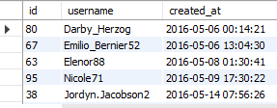
Insights
Rewarding Most Loyal Users
Q1. Find the 5 oldest user of Instagram?
Query:
SELECT * FROM ig_clone.users
ORDER BY created_at;
Result:

Slide 7
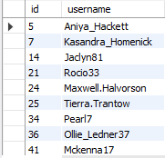
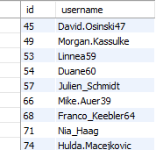
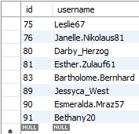
Insights
Remind Inactive Users to Start Posting:
Q2.Find the user who have never posted any photo on Instagram?
Result:
Query:
select id, username
from ig_clone.users
where id not in(select distinct user_id from photos);

Slide 8

Insights
Declaring Contest Winner:
Q3.Identify the winner of contest and provide their details to team(who get most like on a single photo)?
Query:
select * from ig_clone.users
where id =( select user_id from ig_clone.photos
where id = ( select photo_id from ig_clone.likes
group by photo_id
order by count(user_id)
desc limit 1));
Result:

Slide 9
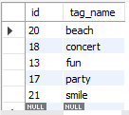
Insights
Hashtag Researching
Q4.Identify and suggest top 5 most commonly used hashtag used on the platform.
Query:
select id, tag_name
from ig_clone.tags
where id in (select tag_id from (select tag_id, count(photo_id) as tag_count from ig_clone.photo_tags group by tag_id order by tag_count desc limit 5) top_tag ) ;
Result:

Slide 10
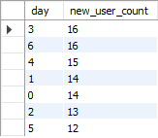
Insights
Launch AD Campaign
Q5. What day of the week do most users register on? Provide insights on when to schedule an ad campaign.
Query:
SELECT weekday(created_at) as day, count(id) as new_user_count
FROM ig_clone.users
GROUP BY day
ORDER BY new_user_count desc;
Result:
Note: 0= Monday, 1 = Tuesday, 2 = Wednesday, 3 = Thursday, 4 = Friday, 5=Saturday, 6 = Sunday.

Slide 11


Insights
User Engagement
Provide how many times does average user posts on Instagram. Also, provide the total number of photos on Instagram/total number of users.
Query 1:
SELECT round(avg(photo_count)) as 'average_post‘
FROM ( select user_id, count(id) as photo_count from ig_clone.photos group by user_id)temp;
Query 2:
select (select count(id) as total_photos from ig_clone.photos)/ (select count(id) as total_users from ig_clone.users) as "Total photos / Total users";
Result 1:
Result 2:

Slide 12
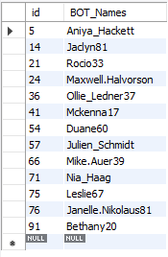
Insight
Bot and Fake Accounts:
Provide data on (bots) who have liked every users (bots) who have every single photo on the site (since any normal user would not be able to do this).
Query:
SELECT id, username as BOT_Names FROM ig_clone.users
WHERE id in (SELECT user_id FROM ig_clone.likes GROUP BY user_id having count(photo_id) = ( select count(id) as Total_Photos FROM ig_clone.photos));
Result:

Slide 13
Result
By completing this project, I have learned SQL workbench usage and its application along with its benefit.
Through this project, I came to know about usage of analytics in Instagram for the insight that helps in progress of application.
It helped me to brush up my concepts related to sub-queries and aggregate function.
It helped me to understand the table schema .
It helped me to understand dataset through normalization.

Slide 14
Thank you
BY –ROHIT BAHUGUNA

